Slide 1

Innopolis University
Control Theory (Linear Control)
Lecture 6
Linear-quadratic regulator (LQR)
Hamilton-Jacobi-Bellman Equation
Sergei Savin, PhD
Slides design by Marko Pezer & Artem Bakhanov

Slide 2
Topic of the Lecture
Linear-quadratic regulator (LQR)
Hamilton-Jacobi-Bellman Equation
Algebraic Riccati equation
Control Theory (Linear Control)
Slide 2

Slide 3
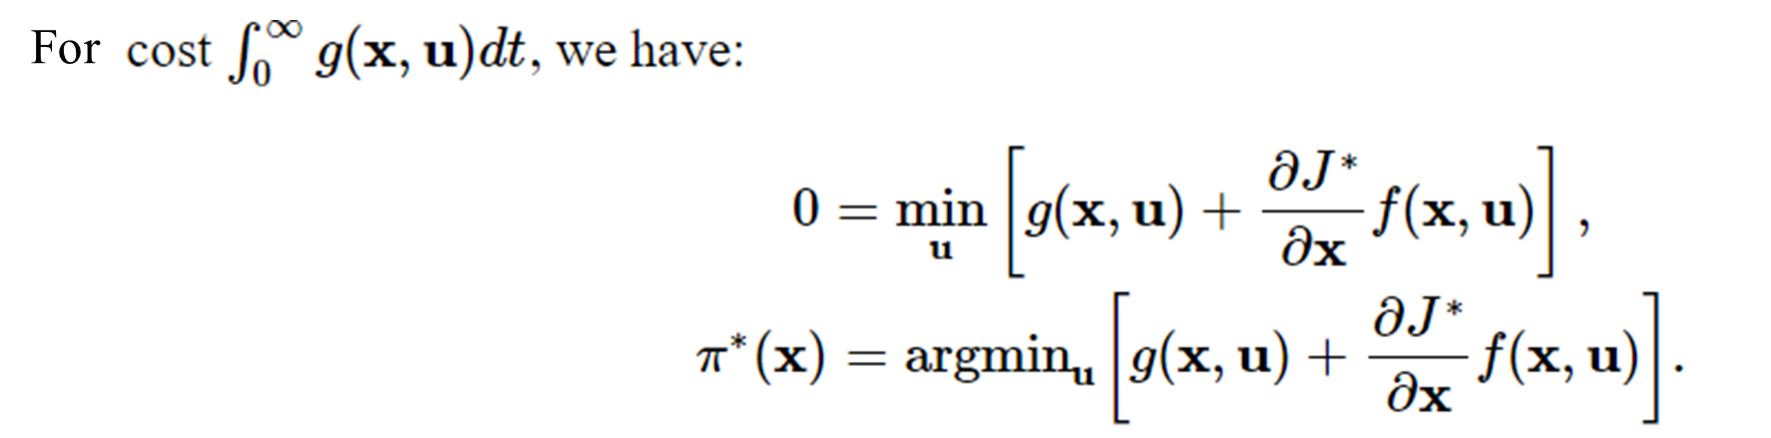
Hamilton-Jacobi-Bellman Equation
Examples:
https://www.youtube.com/watch?v=rbEyP0xKuB4&t=2s
Control Theory (Linear Control)
Slide 3

Slide 4
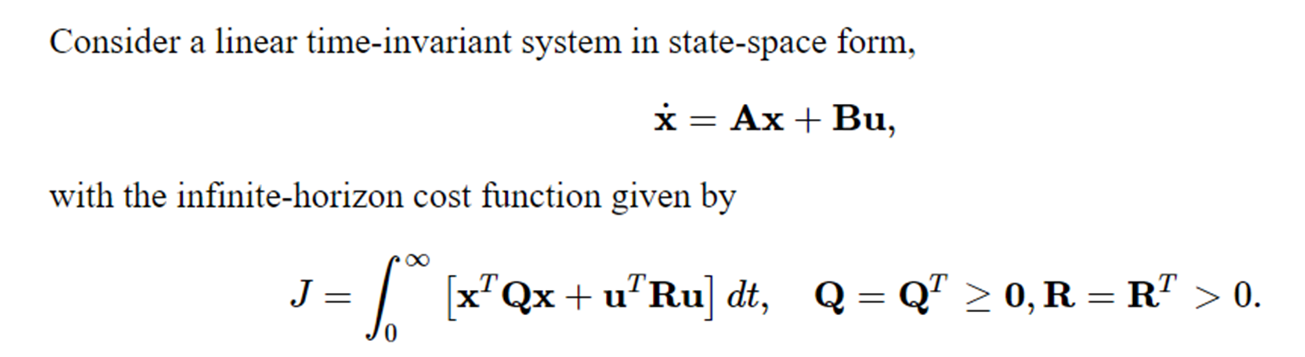
Linear Case
Control Theory (Linear Control)
Slide 4

Slide 5
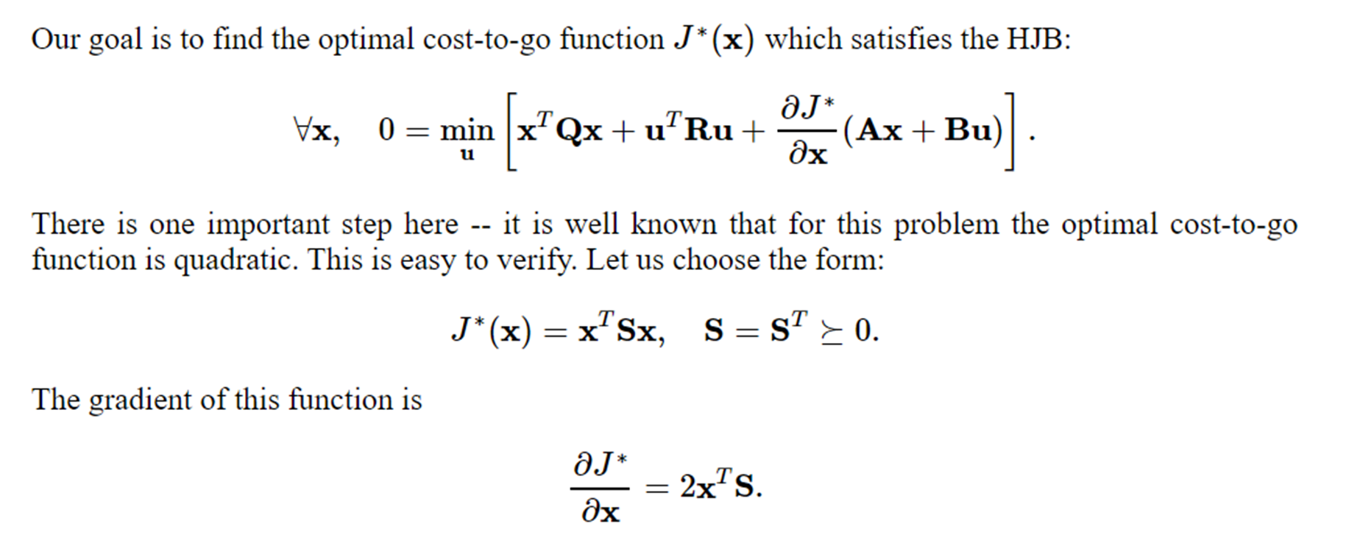
Algebraic Riccati Equation
Explanation:
https://www.youtube.com/watch?v=3heIoKDhN3E
Control Theory (Linear Control)
Slide 5

Slide 6
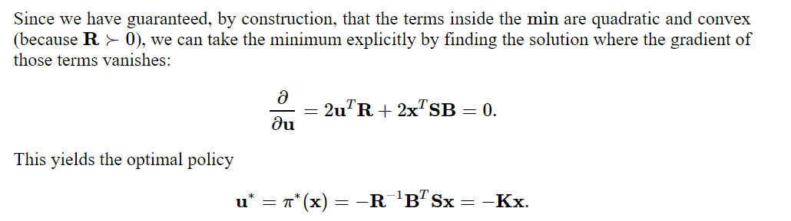
Feedback Law
Control Theory (Linear Control)
Slide 6

Slide 7
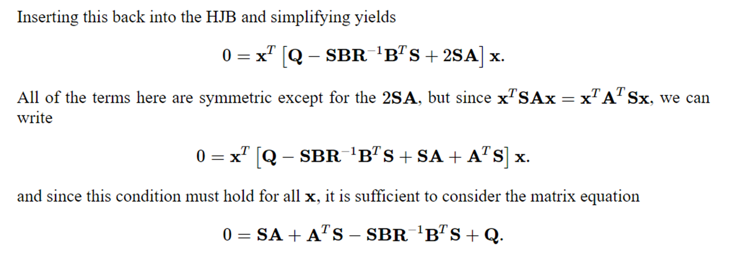
Algebraic Riccati Equation Solution
Control Theory (Linear Control)
Slide 7

Slide 8
The End
Do you have any questions?

